Slide 1

The Case for Financing Older America’s
Long-Term Care Need

Slide 2
Where We Stand
As we age, needing help to take care of ourselves is a risk we all face regardless of gender, ethnicity, income, wealth, and other characteristics. This risk increases over time. Half of Americans who live to age 65 will — at some point — need help with multiple basic life tasks, and a smaller percentage of us will need help spanning many years.
The majority of people with high levels of need live at home and receive care from unpaid family members. When they need services, like personal care or home modifications, they generally pay out of pocket. For very low-income individuals, Medicaid plays an important financing role, particularly for those with long-term care (LTC) needs who have exhausted their savings.

Slide 3
It’s a Crisis: LTC Financing
Individuals are not getting the care they need
Families are facing bankruptcy
Unpaid caregivers are losing wages from missed work and experiencing physical and emotional strain
Federal and state budgets are impacted, as individuals and families turn to Medicaid when their resources are exhausted

Slide 4
Table of Contents
Section 1: America’s Growing Need for Support
Section 2: Today’s LTC Financing System Fails
to Protect Against Major Financial Risk
Section 3: New Insurance-Based Options
for Financing LTC

Slide 5
America’s
Growing Need for Support

Slide 6
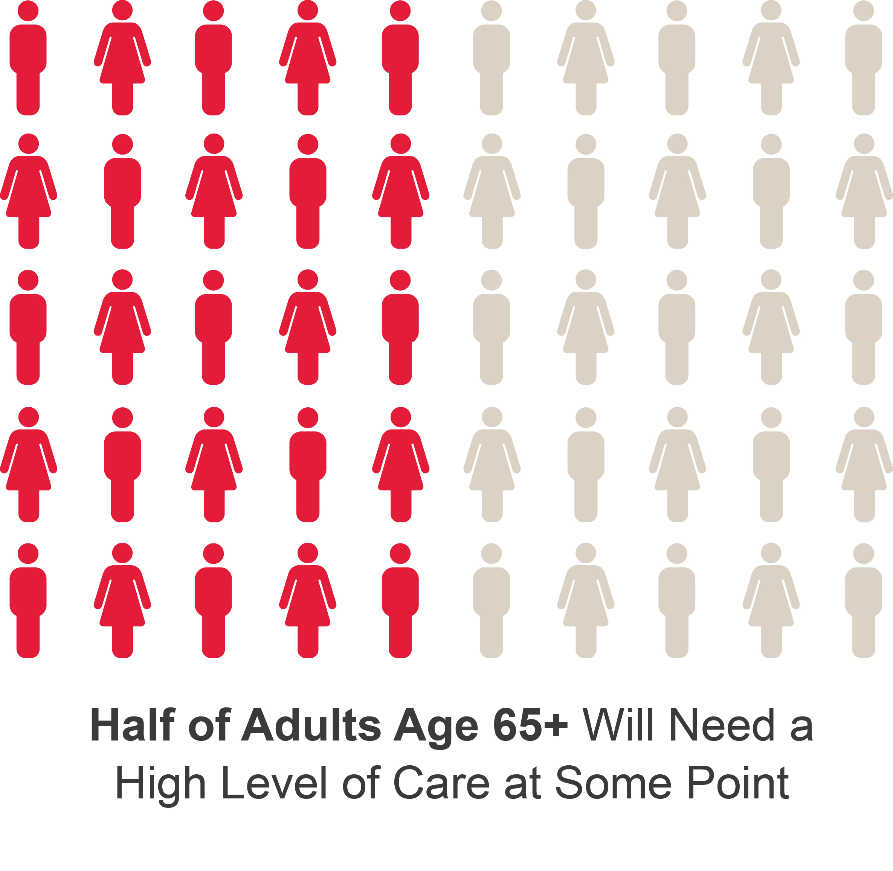
A Risk We All Face
Favreault & Dey (2015), Table 1
Notes:
Adults are defined as those turning 65 between 2015 and 2019
High level of care refers to needing help with two or more activities of daily living (ADLs), or severe cognitive impairment

Slide 7
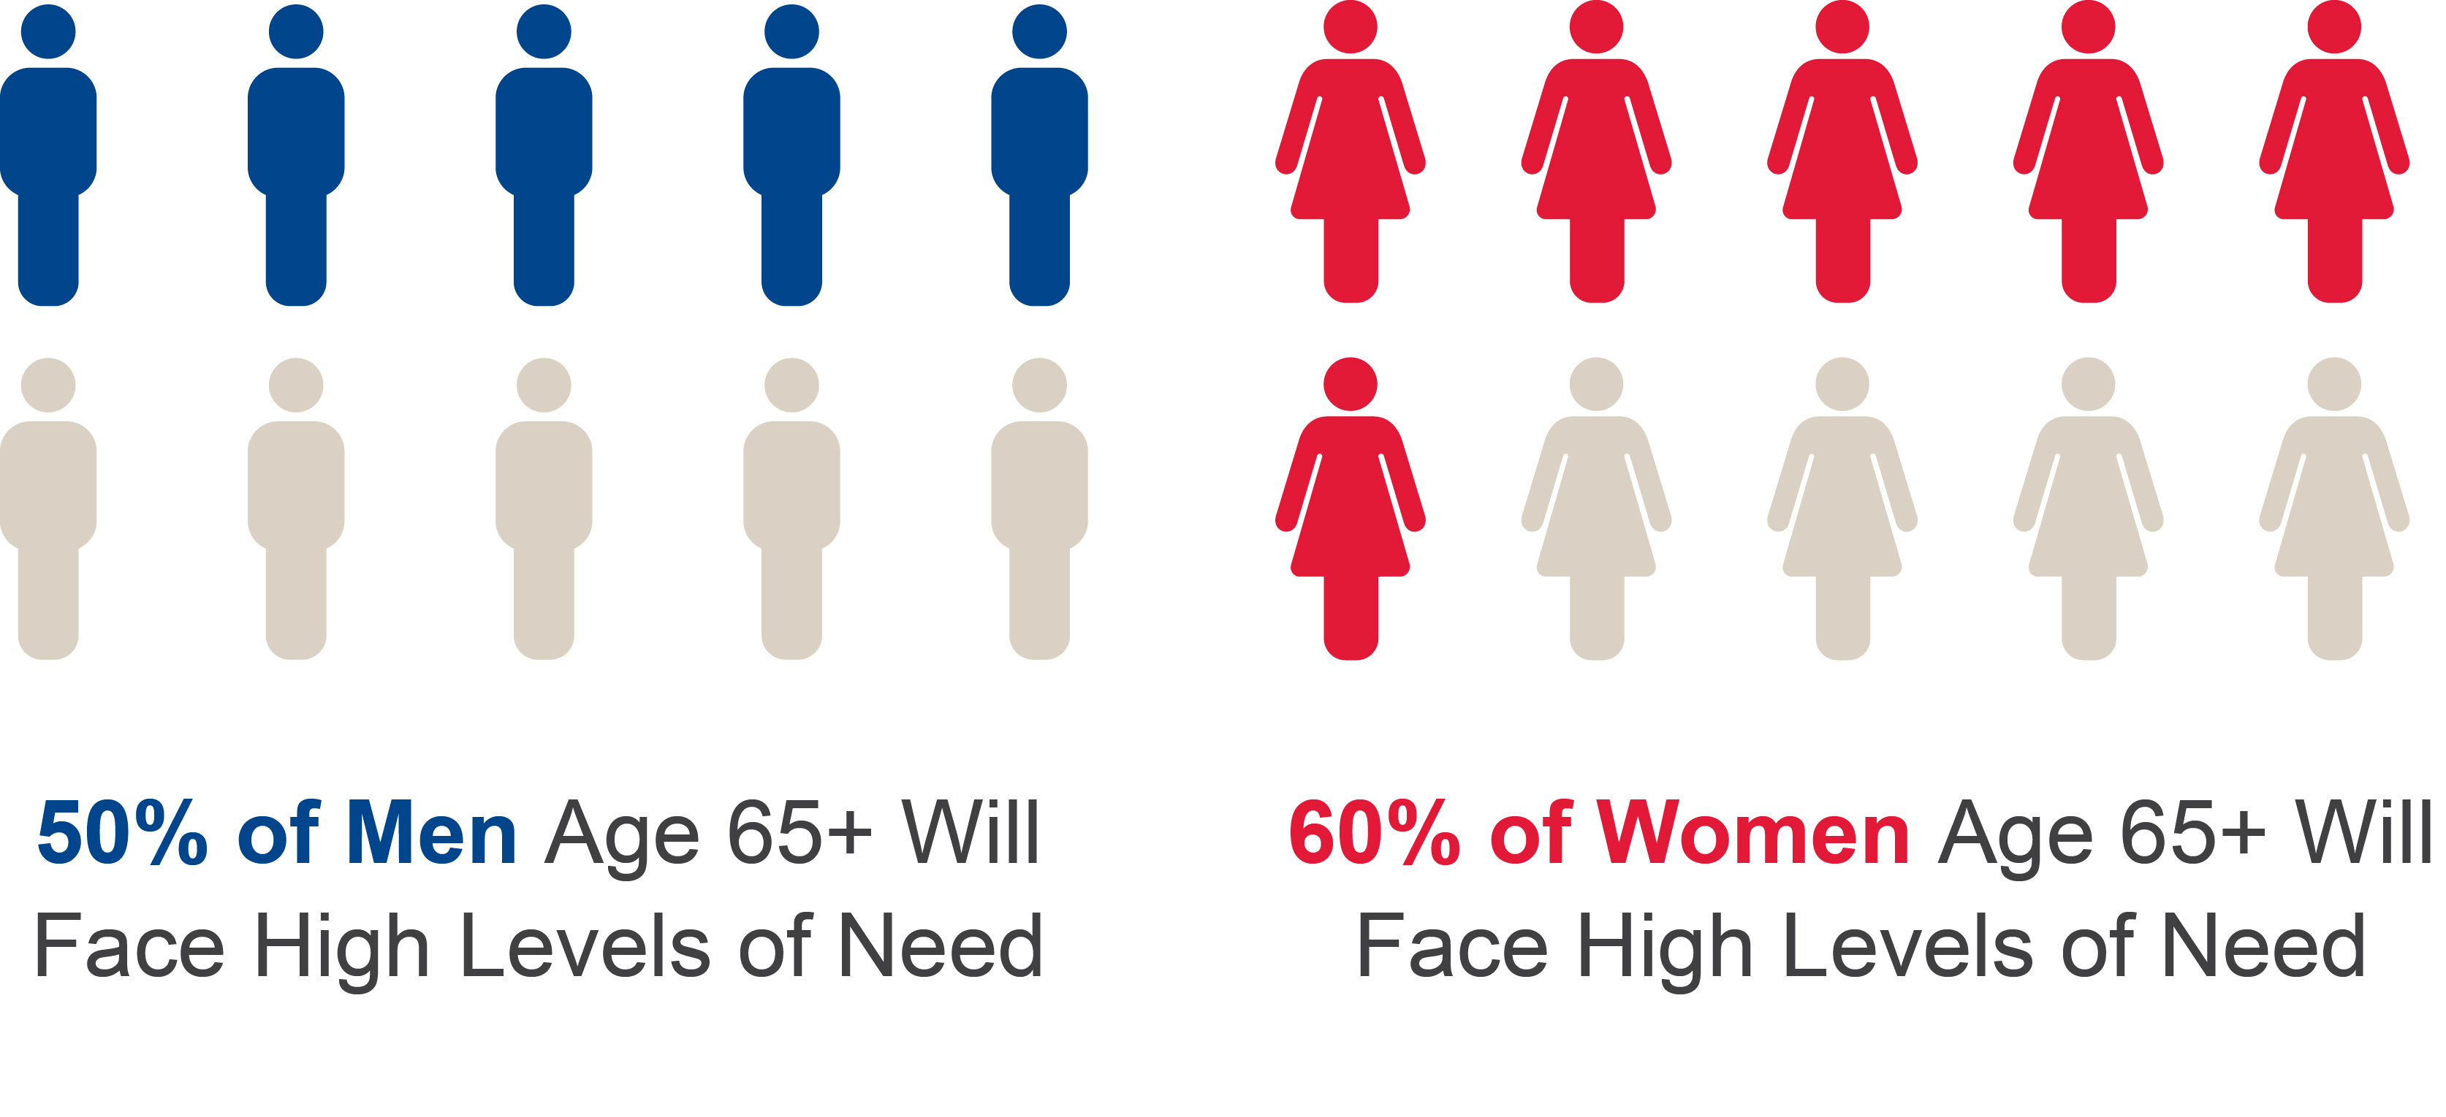
Women Face Higher Lifetime Risk
Note: Percentages in picture are approximate. Actual values are 46.7% of men, and 57.5% of women
Favreault & Dey (2015), Table 1
Notes:
Adults are defined as those turning 65 between 2015 and 2019
High need refers to needing help with two or more activities of daily living (ADLs), or severe cognitive impairment

Slide 8
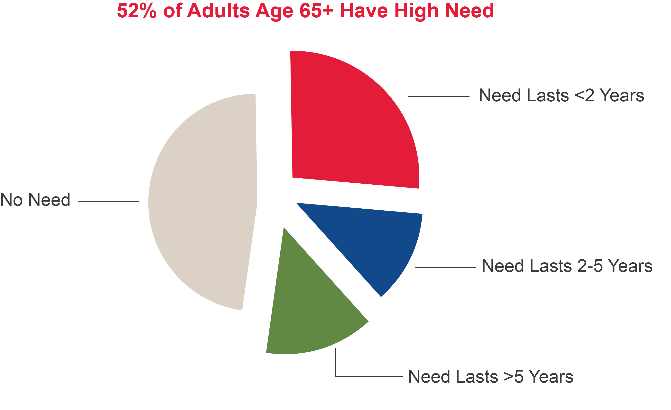
Older Adults Risk Many Years of High Need
Favreault & Dey (2015), Table 1
Notes:
Adults are defined as those turning 65 between 2015 and 2019
High need refers to needing help with two or more activities of daily living (ADLs), or severe cognitive impairment
While not depicted directly on this slide, among those who do need care, about 30 percent will need it for less than a year, but 25 percent will need it for at least five years

Slide 9

3/4 Older Adults with LTC Needs
Live at Home
Freedman & Spillman (2014), Table 2
Notes:
LTC needs are defined as receiving help with daily activities in the last month
1.1 million older adults live in nursing homes; 1.6 million older adults live in supportive housing; and 8.2 million older adults live at home

Slide 10
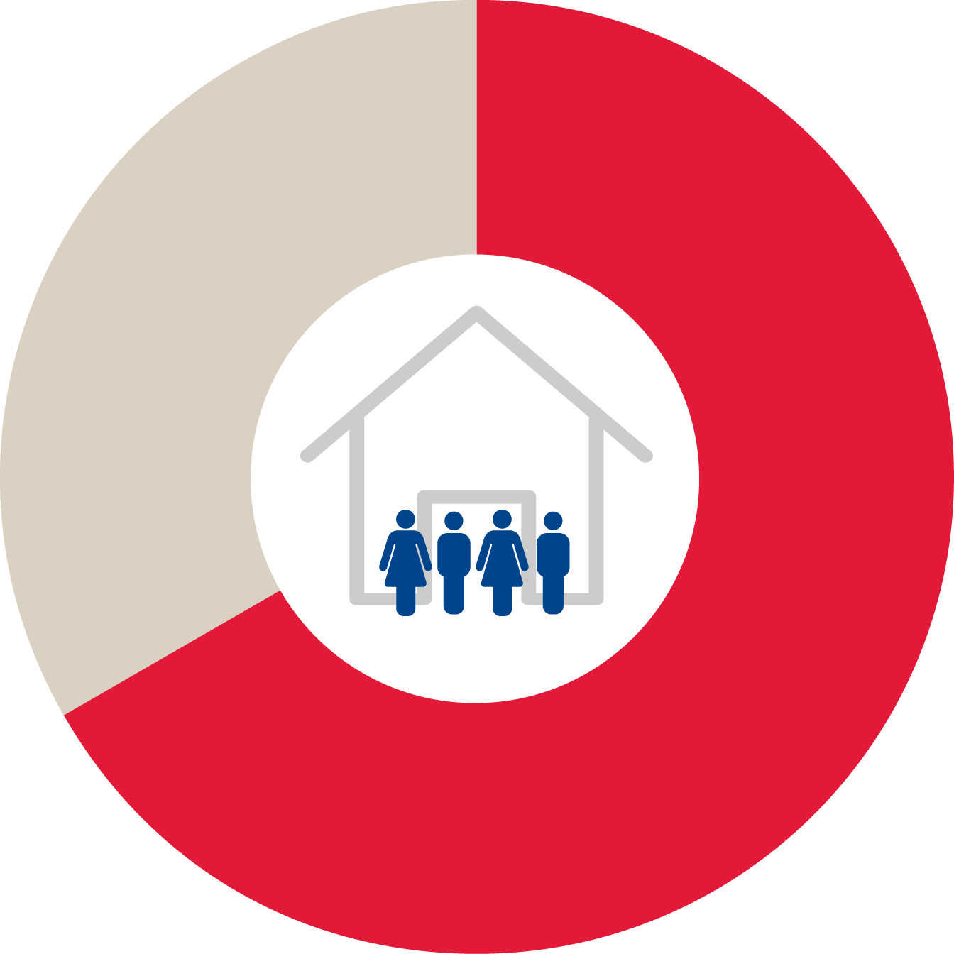
Americans Rely on Unpaid Caregivers
Nearly 2/3
of Older Adults with LTC Needs Living at Home Receive All Help from Unpaid Family and Friends
Note: Excludes individuals living in nursing homes
Freedman & Spillman (2014), Table 2
Notes:
LTC needs are defined as receiving help with daily activities in the last month

Slide 11
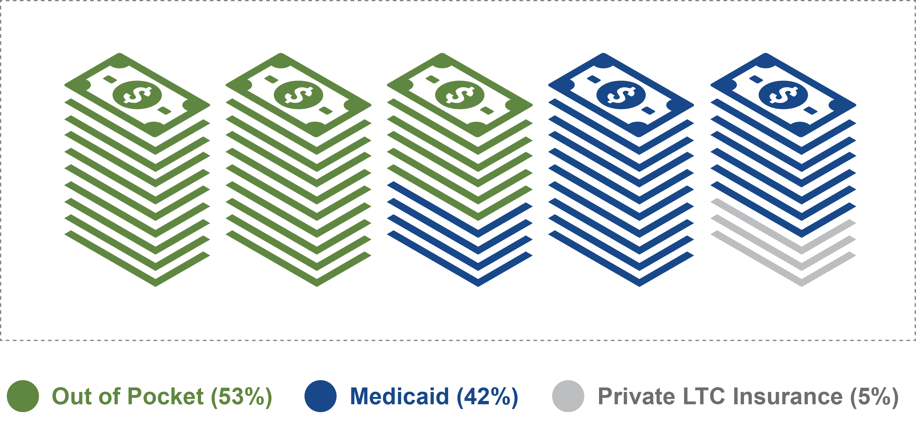
More Than Half of Spending on LTC Is Out of Pocket
Favreault & Johnson (2015), Table 15
Notes:
These percentages are based on the total annual projected spending in 2030, i.e., $382.4 billion.

Slide 12
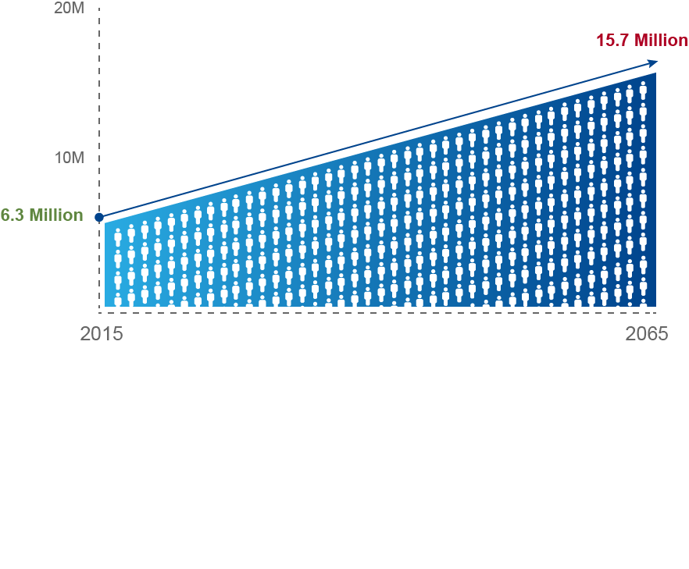
High Need Older Adult Population Rising Fast
Favreault & Dey (2015), Figure 1

Slide 13
Today’s LTC
Financing System Fails to Protect Against Major Financial Risk

Slide 14
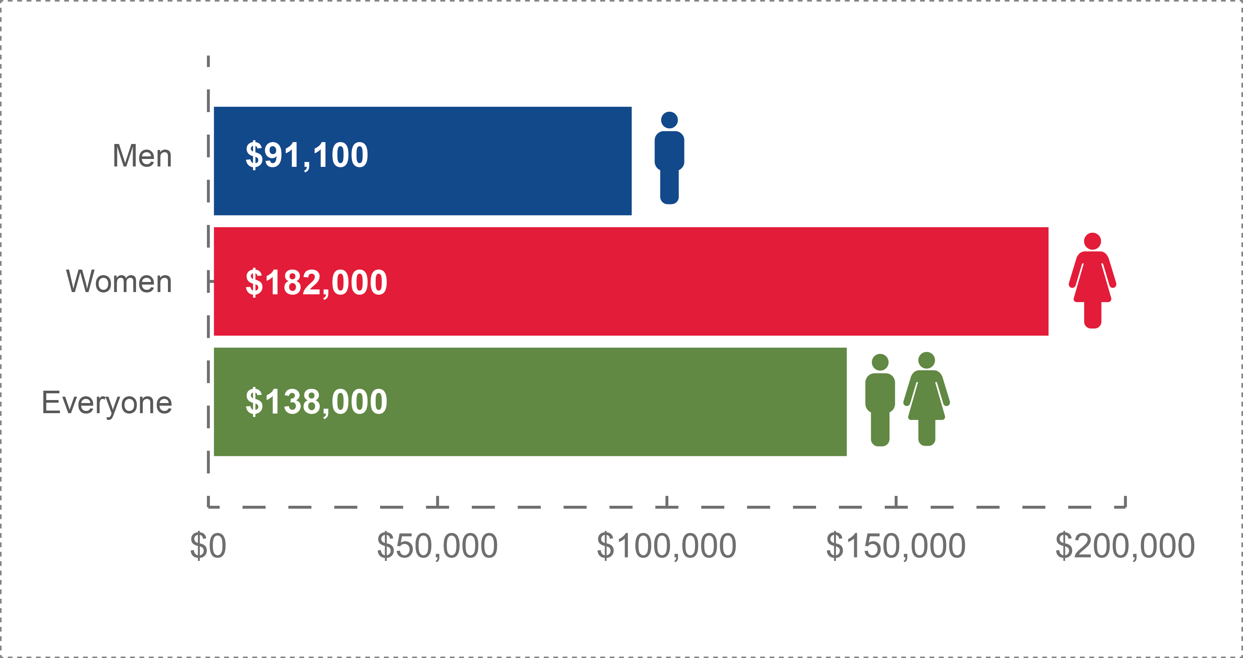
Women’s Lifetime LTC Costs Are 2x Men’s
Favreault & Dey (2015), Tables 4A-4B
Notes:
This represents lifetime costs for adults turning 65 between 2015 and 2019

Slide 15
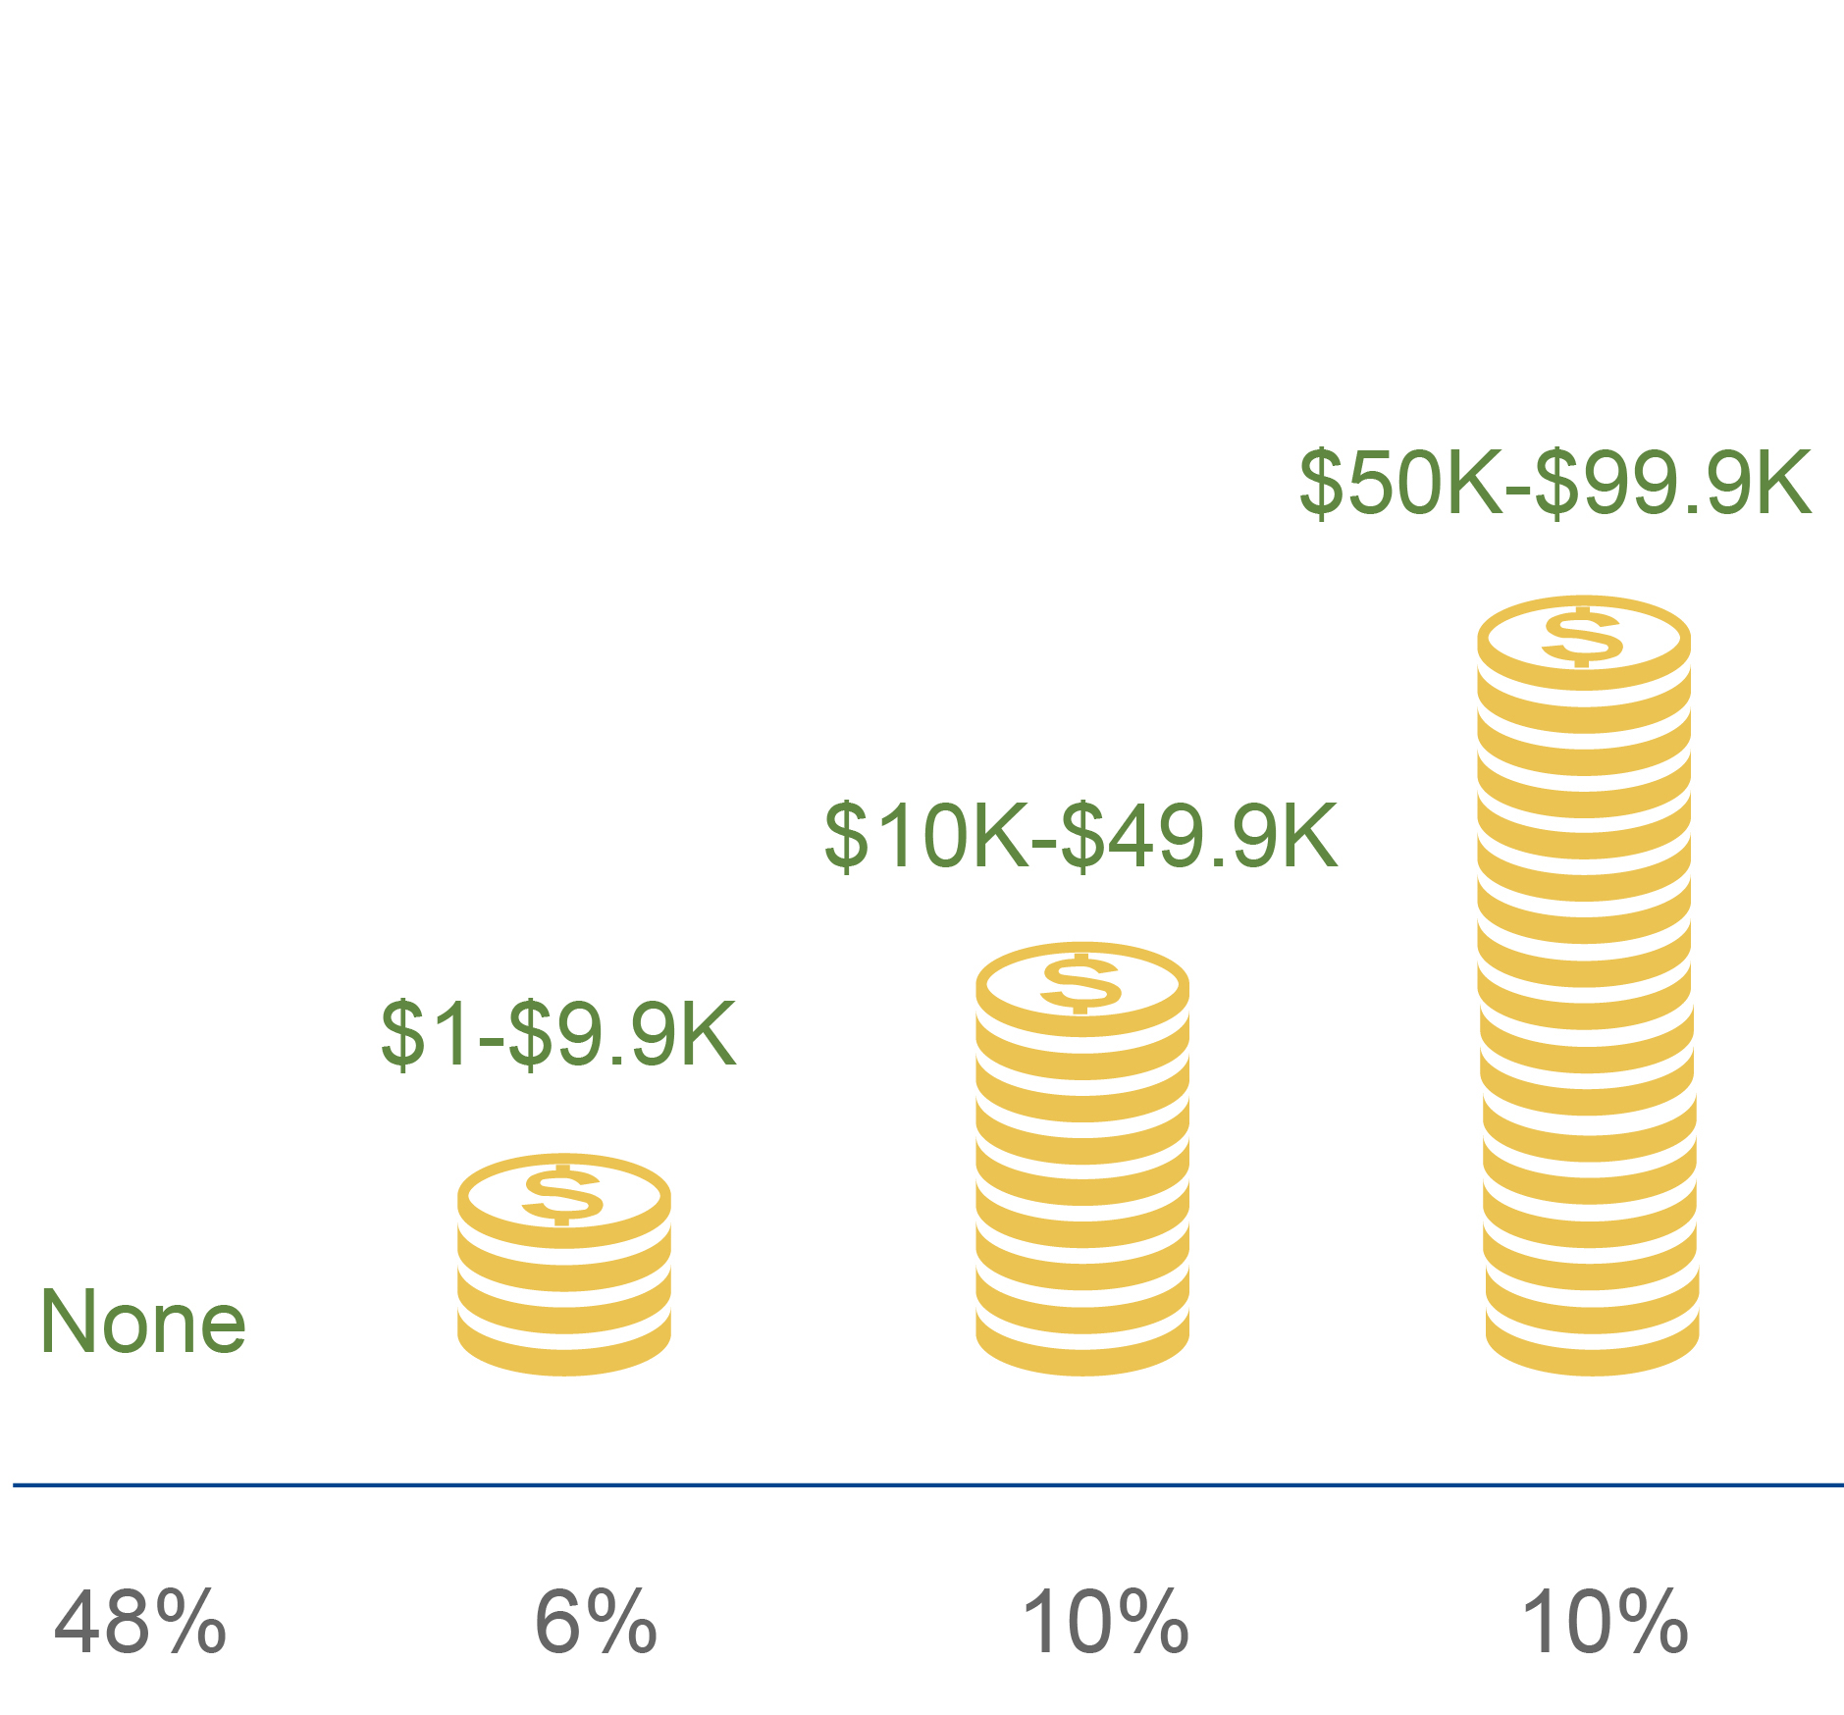
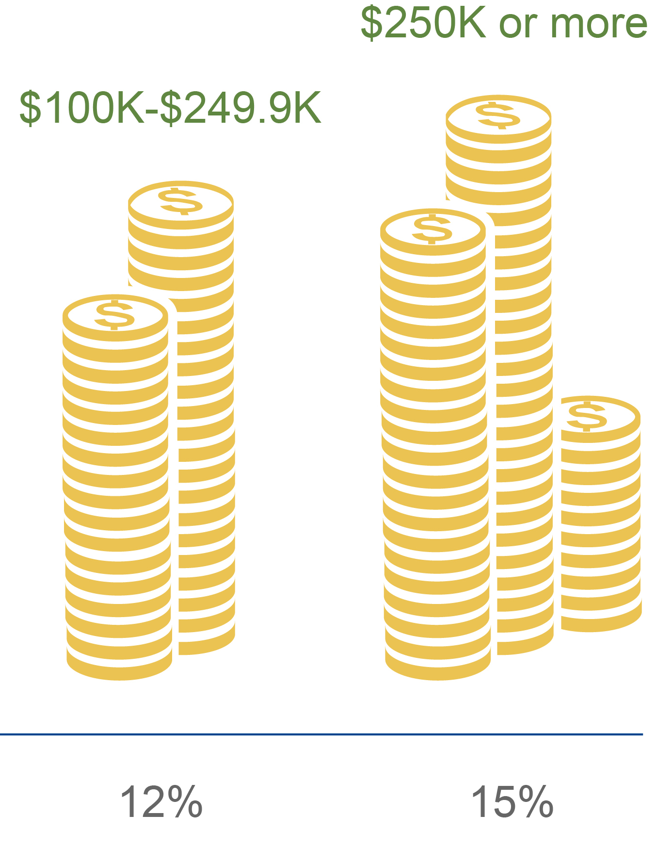
Many Older Adults Face VERY High
LTC Costs Over Lifetime
Favreault & Dey (2015), Table 5
Notes:
These are older adults turning 65 between 2015 and 2019

Slide 16


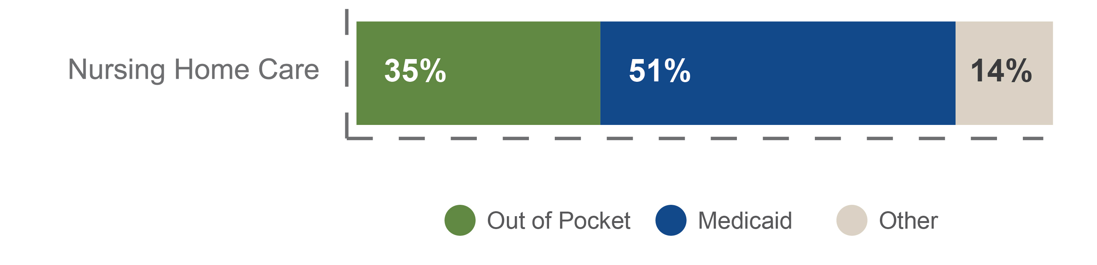
Medicaid & Out of Pocket Cover Most Lifetime Average LTC Spending
Note: The estimated remainder of spending (Other) includes a combination of private LTC insurance and Medicare
Favreault & Dey (2015), Table 3A
Notes:
Cohort in data is older adults turning age 65 between 2015-2019
Lifetime spending for all services is $138,000. For Home and Residential Care, it is $72,800. For Nursing Home Care, it is $65,300
Although we are showing the small portion “Other” (e.g., Medicare), it relates to services such as Home Health, which is covered by Medicare in only limited circumstances and for a short duration

Slide 17
New Insurance-Based Options for Financing LTC

Slide 18
No Single Approach
The Urban Institute examined the impact of insurance options to cover LTC risk in old age. Each covered different portions of lifetime need:
  Front-End: Insurance that covers only the first two years of need
  Catastrophic: Insurance coverage that begins after the first two years of need and continues through lifetime
  Comprehensive: Insurance which begins at the point of need and continues through lifetime
Urban evaluated each of these approaches to risk for both mandatory insurance – where everyone participates – and voluntary insurance.
Notes:
Urban Institute authors note that while no one solution is the “silver bullet” that could fully address the challenge of long-term care financing in the United States, each would be an improvement over the current baseline

Slide 19
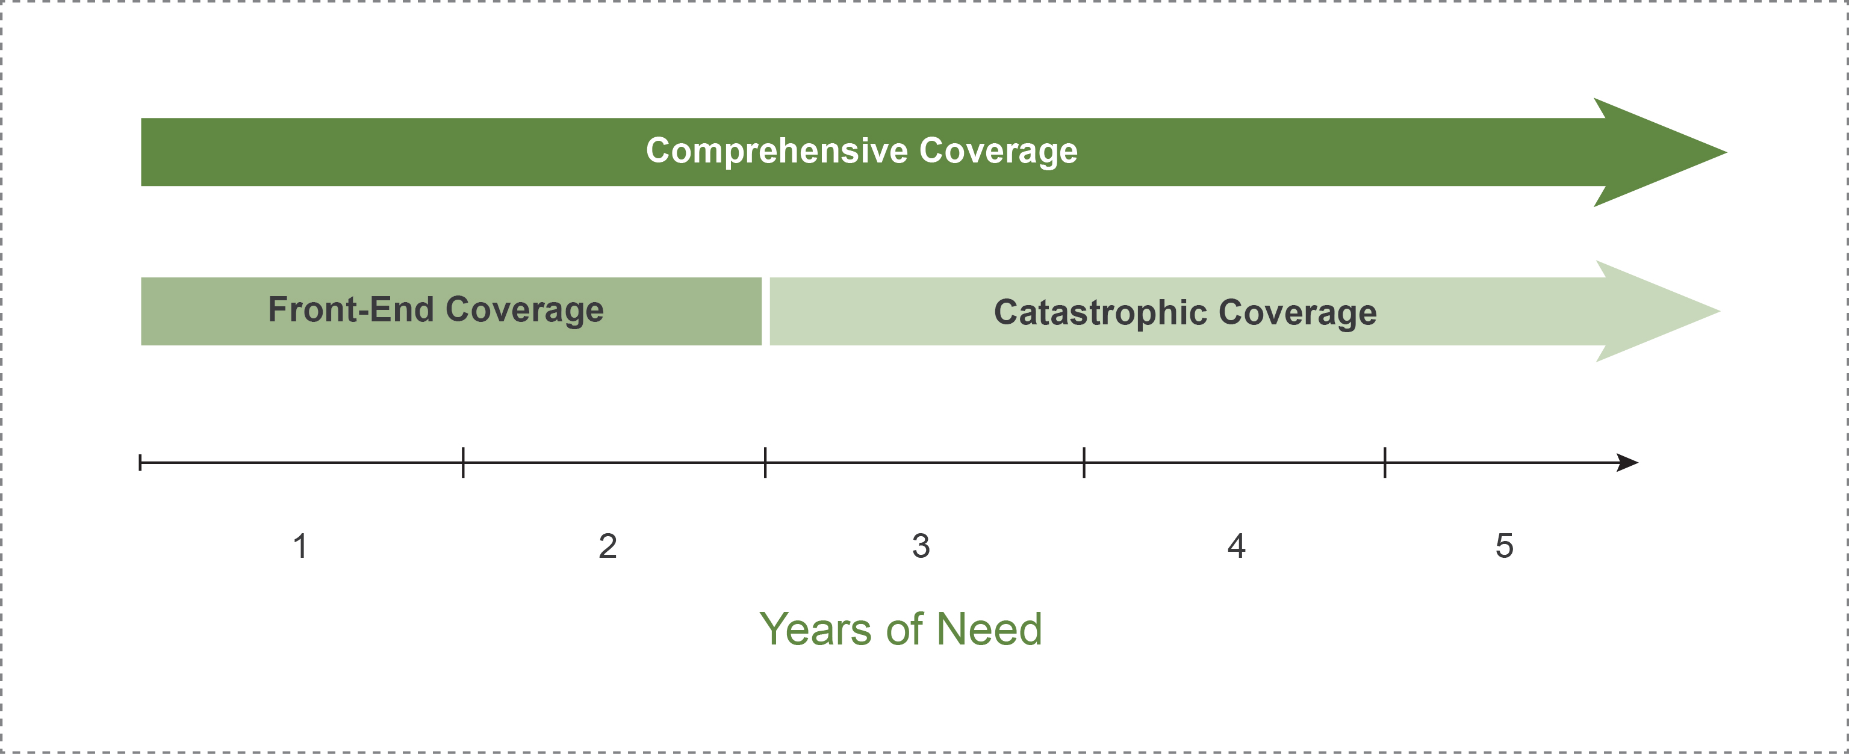
Mandatory & Voluntary:
Three Approaches to Covering Risk

Slide 20
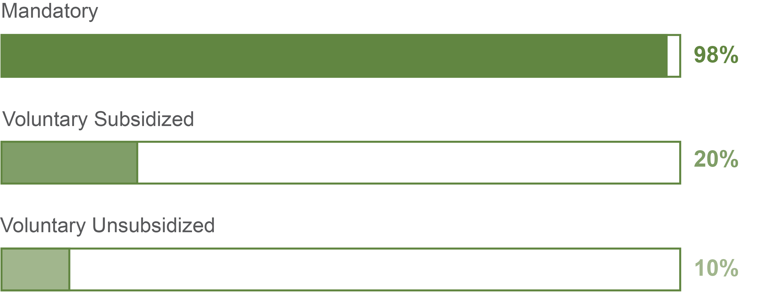
Percent Older Adults Covered by Options
Note: Percentages are approximate for all options
Favreault, Gleckman & Johnson (2015), Exhibit 2
Notes:
Coverage estimates are for adults born between 1976-1990, and for everyone either participating in new insurance or having an alternative private insurance
Mandatory approaches cover substantially more people
According to the authors, the baseline – or no new insurance – generates rates of coverage that are a few percentage points below the voluntary unsubsidized options

Slide 21
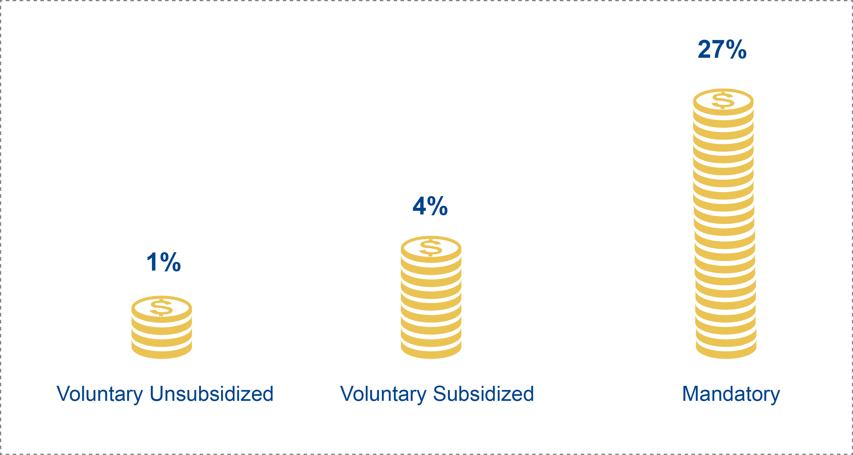
Mandatory Option Creates Largest
Medicaid & Out-of-Pocket Savings
Favreault & Johnson (2015), Table 15
Notes:
Data, calculated for the year 2050, combines savings totals from both Medicaid and out-of-pocket spending compared to baseline

Slide 22
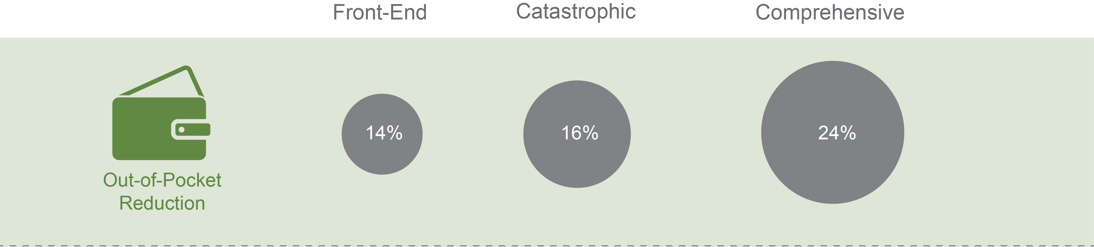

Impacts of Mandatory Approaches
Favreault & Johnson (2015), Table 15
Notes:
Data is for projections in 2050
The options reduced spending in Medicaid and Out of Pocket in all categories, but the largest reductions for Medicaid and Out of Pocket are with the Catastrophic and Comprehensive approaches

Slide 23
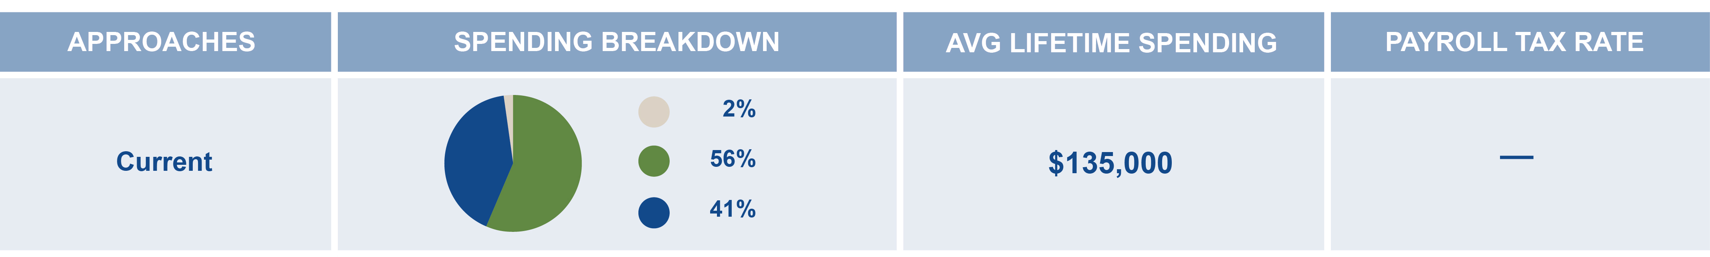


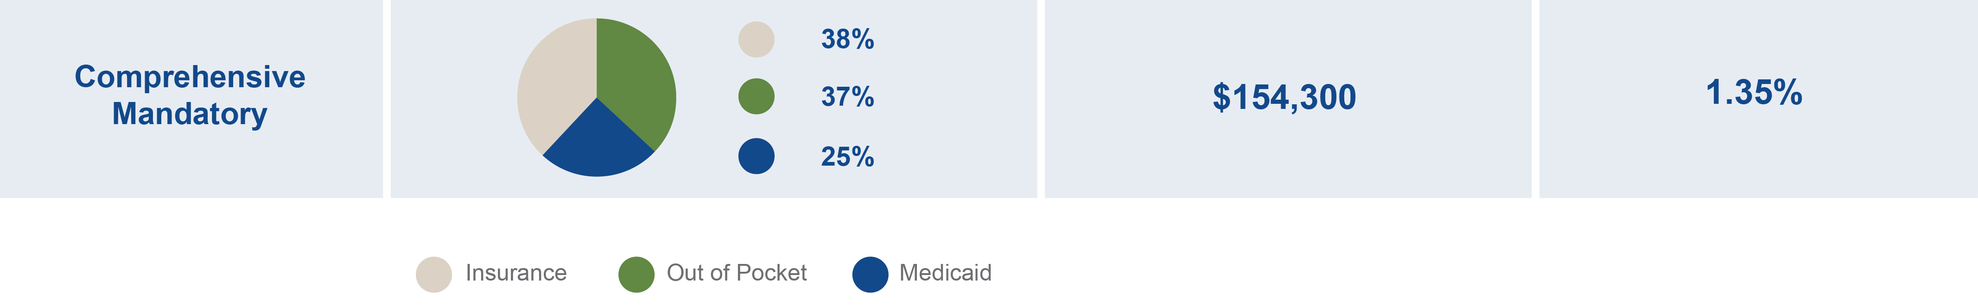
New Mandatory Approaches Shift
Spending in Different Ways
Favreault & Johnson (2015), Tables 1 and 16
Notes:
Lifetime spending estimates are for older adults born between 1956-1960
Effective insurance options do not reduce overall spending. They actually add funding that addresses unmet needs and reduce the burden on individuals’ out-of-pocket spending and pressure on state Medicaid systems
Because most voluntary enrollees contribute for fewer years, their annual premiums would be higher than a payroll tax contribution for a mandatory program, which would require contributions of over an enrollees’ entire career
Premiums for voluntary programs are available in Table 1 of the source document
Taxes are shown for new insurance programs in 2016

Slide 24
Sources
Favreault, M. M., & Dey, J. (2015). Long-Term Services and Supports for Older Americans: Risks and Financing Research Brief. Retrieved from https://aspe.hhs.gov/basic-report/long-term-services-and-supports-older-americans-risks-and-financing-research-brief (Favreault & Dey, 2015)
Favreault, M. M., Gleckman, H., & Johnson, R. W. (2015). Financing Long-Term Services and Supports: Opinions Reflect Trade-Offs for Older Americans and Federal Spending. Health Affairs, 34(12). Retrieved from http://content.healthaffairs.org/content/early/2015/11/13/hlthaff.2015.1226.full
(Favreault, Gleckman & Johnson, 2015)
Favreault, M. M., & Johnson, R. W. (2015, November). Microsimulation Analysis of Financing Options for Long-Term Services and Supports. Research Report for The SCAN Foundation. Retrieved from http://www.thescanfoundation.org/sites/default/files/nov_20_revised_final_microsimulation_analysis_of_ltss_report.pdf (Favreault & Johnson, 2015)
Freedman, V. A., & Spillman, B. C. (2014). Disability and Care Needs Among Older Americans. The Milbank Quarterly, 92(3), 509-541.
(Freedman & Spillman, 2014)
The SCAN Foundation. http://www.TheSCANFoundation.org/ltc-financing-initiative
#LTCFinancing

